Slide 1
Fundamental of Cloud Computing and IoT
JIT

Slide 2
Fundamental of Cloud Computing
and IoT
Introduction to Cloud Computing
Service and Deployment Model
Cloud Challenges and Security issues
01
02
03
Evolution
Definition
Characteristics of cloud Computing
Advantage and Dis advantage
Benefit of Cloud computing
Application of Cloud Computing
Datacenter and Virtualization
Service Model
IAAS
PAAS
SAAS
Deployment Model
Public
Private
Hybrid
Cloud Computing Challenge
Cloud Computing Privacy
Big Data and Cloud Security
Data Security
06
Introduction to IoT
Data management in Cloud and Big Data
Introduction to IoT
Application
Device and Wireless Network
IoT Devices and Architecture
04
05
Advanced Cloud Concepts
Data Management in Cloud
Big Data Analytics
Cloud Management
Data Management
Regulatory Compliance
Forensics and Malware
Miscellaneous Topic in the Cloud
DevOps and the Cloud
IaaS Networking

Slide 3
Fundamental of Cloud Computing
and IoT
01
Introduction to Cloud Computing
Overview
Evolution
Definition
Characteristics of cloud Computing
Advantage and Dis advantage
Benefit of Cloud computing
Application of Cloud Computing
Datacenter and Virtualization,
4

Slide 4
01
Overview of Computing
Computing is the process of using computer technology to complete a given goal-oriented task.
Computing may encompass the design and development of software and hardware systems for a broad range of purposes
Computing describes the way how computers and computer systems work and how they are constructed and programmed.
For example, cloud computing, social computing, ubiquitous computing, parallel computing and grid computing all fall under the umbrella of the general meaning of computing

Slide 5
01
Overview of Computing
Centralized systems are systems that use client/server architecture where one or more client nodes are directly connected to a central server.
This is the most commonly used type of system in many organizations where a client sends a request to a company server and receives the response.
In decentralized systems, every node makes its own decision. The final behavior of the system is the aggregate of the decisions of the individual nodes. Note that there is no single entity that receives and responds to the request.

Slide 6
01
Overview of Computing
Distributed Systems follow a peer-to-peer architecture, it is a collection of independent computers interconnected via a network.
Each node in a distributed system possesses enough computational power to collaborate on a task.
In a distributed system users have equal access to data and user privileges can be enabled as required.
Failure of independent components does not affect the overall system which results in higher availability and improved reliability.
Distributed systems have evolved to address the limitations and problems faced by traditional centralized systems such as security, data storage, and privacy concerns.

Slide 7
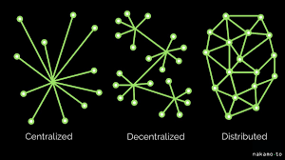
01
Overview of Computing
Centralized, Decentralized and Distributed

Slide 8
01
Overview of Cloud Computing
Cloud Computing is a general term used to describe a new class of network based computing that takes place over the Internet,
basically a step on from Utility Computing
a collection/group of integrated and networked hardware, software and Internet infrastructure (called a platform).
Using the Internet for communication and transport provides hardware, software and networking services to clients
These platforms hide the complexity and details of the underlying infrastructure from users and applications by providing very simple graphical interface or API (Applications Programming Interface).
4

Slide 9
01
Evolution of Cloud Computing
1st
Early 1960s
2nd
Early 1960s
Utility Computing.
Cluster Computing
Early 1990s
3rd
Grid Computing
Early 2000s
4th
Early 2010s -2012
Cloud Computing
5th
Fog Computing

Slide 10
01
Overview of Cloud Computing
The rising popularity of the Internet and the availability of powerful computers and high-speed networks as low-cost commodity components are changing the way we do computing.
Through the 1990s to 2012 the internet changed the world of computing drastically.
It started with parallel computing after it advanced to distributed computing and further to grid computing.
Now it creates a new world which is pronounced as a Cloud Computing.
Cloud computing is the most recent announced technology that has been launched on the network world.

Slide 11
01
Overview of Cloud Computing
There are various types of computing technologies:
Utility computing/1960s
Cluster computing/1960s
Grid computing/1990s
Cloud computing/2000s- 2007
Fog Computing/2012

Slide 12
01
Overview of Cloud Computing
1. Utility computing/1960s:
Utility computing is the process of providing computing service through an on-demand, pay-peruse billing method.
Utility computing is a computing business model in which the provider owns, operates and manages the computing resources, infrastructure and the subscribers accesses it as and when required on a rental or metered basis,
This model is based on that used by conventional utilities such as telephone services, electricity and gas.
Utility computing solutions consists of virtual servers, virtual storage, virtual software, backup and most IT solutions

Slide 13
01
Overview of Cloud Computing
1. Utility computing/1960s:
Some organizations do this to save money since they only pay for services they require rather than purchasing a whole product suite with a flat monthly or yearly rate.
Utility computing can provide services such as storage space, applications, and even the hardware itself.
Due to its flexibility and economy, utility computing is one of the most popular IT service models.
Grid computing, cloud computing and managed IT services are based on the concept of utility computing.
The backend infrastructure and computing resources management and delivery is governed by the provider.

Slide 14
01
Overview of Cloud Computing
1. Utility computing/1960s:
Pros:
An organization does not need to purchase full software suites, licenses, or even hardware themselves.
They only need to pay for services that they actually need
Software updates are essential to the performance and security of software and the hardware it inhabits.
When you employ a utility computing model, the contracted company is responsible for maintaining the software, and hardware that they have rented out to you
Can help organizations standardize the service offering across departments.

Slide 15
01
Overview of Cloud Computing
1. Utility computing/1960s:
Cons:
If a utility computing company goes into financial trouble, they can abruptly close, meaning you will be without vital services that you may have already paid for. Do research and ask questions of the state of the chosen company
Utility computing companies can sometimes be attractive targets for cyber-criminals since they may also store the data of their many clients.
For cyber-criminals, an attack on this type of company can produce more than an attack on a single organization alone

Slide 16
01
Overview of Cloud Computing
2. Cluster Computing/1960s:
For many years supercomputer was the leader in the field of computing.
Cluster computing refers to several computers on one network, acting as a single entity.
Individual computers on this network are called nodes.
A cluster computing is a type of parallel or distributed processing system, which consists of a collection of interconnected stand-alone computers working together as a single integrated computing resource.
The components of a cluster are commonly, but not always, linked to each other through fast local area networks.

Slide 17
01
Overview of Cloud Computing
2. Cluster Computing/1960s:
Pros:
Faster processing speeds for overall higher performance
Ensures computing power is always readily available
An economic choice thanks to its scalable nature
Cons:
Requires more physical space, as more computers operate in a single location
Uses more power, when compared to a single server

Slide 18
01
Overview of Cloud Computing
3. Grid Computing/1990s:
Grid computing refers to a group of computers that work together as part of one system, connected by a central network.
Grid is often constructed across LAN, WAN, or Internet backbone networks at regional, national, or global scales.
Enterprises or organizations present grids as integrated computing resources.
They can be viewed also as virtual platforms to support virtual organizations.
Grid computing refers to a network of the same or different types of computers whose target is to provide an environment where a task can be performed by multiple computers together on a need basis.

Slide 19
01
Overview of Cloud Computing
3. Grid Computing/1990s:
Basically, Grid Computing is a network-based computing model capable of processing a massive amount of data.
It is managed by a group of computers, and they coordinate with each other to solve big problems.
The computers used in a grid are primarily workstations, servers, clusters, and supercomputers.
Personal computers, laptops and PDAs can be used as access devices to a grid system.

Slide 20
01
Overview of Cloud Computing
3. Grid Computing/1990s:
Pros:
Finish larger projects in a shorter amount of time
Grid computing is modular - that means if one computer fails, the other components of a system can continue to operate
If you have idle servers or computers in your system, a grid computing set-up can put them to work, by providing them a share of a project

Slide 21
01
Overview of Cloud Computing
3. Grid Computing/1990s:
Cons:
Grid computing technology is still new. Therefore, software, and best practices are not yet fully understood
You may need to run big shared-memory multiprocessing tasks for applications that require more memory
Security on these systems can be questionable. That is because the controls on member nodes are not strictly enforced

Slide 22
Grid Computing Vs Cluster Computing
The big difference is that
A cluster is homogenous while grids are heterogeneous.
The computers that are part of a grid can run different operating systems and have different hardware whereas the cluster computers all have the same hardware and OS.
A grid can make use of spare computing power on a desktop computer while the machines in a cluster are dedicated to work as a single unit and nothing else.
Grid are inherently distributed by its nature over a LAN, metropolitan or WAN. On the other hand, the computers in the cluster are normally contained in a single location or complex.
Grid are not controlled centrally but have their own management and ownership. If this is not the case, the term cluster seems more appropriate.

Slide 23
Grid Computing Vs Cluster Computing
Grid computing is a form of distributed computing whereby resources of many computers in a network is used at the same time, to solve a single problem.
What distinguishes grid computing from conventional cluster computing systems is that grids tend to be more loosely coupled, heterogeneous, and geographically dispersed.
On Cluster ,the whole system (all nodes) behave like a single system view and resources are managed by centralized resource manager. In case of Grid, every node is autonomous i.e. it has its own resource manager and behaves like an independent entity.
grid computing relies on an application to be broken into discrete modules, where each module can run on a separate server. Cluster computing typically runs an entire application on each server, with redundancy between servers.

Slide 24
01
Overview of Cloud Computing
3. Cloud Computing/2007:
After the grid computing, cloud computing is considered as a new paradigm of Information Technology (IT) that has emerged in 2007.
Cloud Computing is a way to access, store and manipulate data on the Internet environment without wasting lots of computer memory of individual systems.
Cloud computing is a computing style in which flexible and scalable IT functionalities are delivered as a service to end users using Internet.

Slide 25
Grid Computing Vs Cloud Computing
Cloud computing is how data is accessed using remote servers via Internet (known as “the cloud”).
Cloud computing relies on sharing hardware and software resources over a network rather than on local servers or personal devices.
This network of servers and connections is collectively known as the cloud. Google Docs is an example of Cloud computing.
Cloud services can be used to provide high-performance computing, as needed.
Cloud computing is an alternative for existing enterprises to offload overburdened IT infrastructures with value-added capabilities.
With cloud computing, companies can scale up to massive capacities in an instant without having to invest in new infrastructure, train new personnel, or license new software. Cloud computing is of particular benefit to small and medium-sized businesses who wish to completely outsource their data-center infrastructure, or large companies who wish to get peak load capacity without incurring the higher cost of building larger data centers internally. In both instances, service consumers use what they need on the Internet and pay only for what they use.

Slide 26
Grid Computing Vs Cloud Computing
Cloud computing evolves from grid computing and provides on-demand resource provisioning.
Grid computing may or may not be in the cloud depending on what type of users are using it.
If the users are systems administrators and integrators, they care how things are maintained in the cloud. They upgrade, install, and virtualize servers and applications. If the users are consumers, they do not care how things are run in the system.
in a cloud computing environment, there are often multiple servers which can each perform a single task excellently. Using the cloud gives a user access to all these servers through one interface.

Slide 27
Grid Computing Vs Cloud Computing
SR.N | Cloud Computing | Grid Computing
1 | Cloud Computing is based on the Client-Server Architecture. | Grid Computing is based on the Distributed Computing Architecture.
2 | It is a centralized management system. | While Grid Computing is a decentralized management system.
3 | Cloud Computing is flexible compared to Grid Computing. | Grid Computing is less flexible compared to Cloud Computing.
4 | The users pay for what they use (Pay-as-you-go Model) | The user does not have to pay for any usage.
5 | Cloud Computing is highly scalable than Grid Computing. | Grid Computing is less scalable than Cloud Computing.
6 | The user can access Cloud Computing with standard web protocols. | The user can access Grid Computing with grid middleware.
7 | In Cloud Computing, the resources are owned by the Cloud service provider. | In Grid Computing grids, the organization is the owner of the grids.
8 | IaaS, PaaS, and SaaS are the three Cloud Computing Services. | Distributed Computing, Distributed information, and distributed pervasive are the systems used in Grid Computing.
9 | While Cloud Computing is Service-Oriented | While Grid Computing is Application-Oriented
10 | In Cloud, Computing users do not have to set up anything | In Grid Computing, the users do not have to set up anything.
11 | Cloud Computing involves dealing with chronic issues with different amounts of computer resources. | Grid Computing offers a shared pool of computing resources.
12 | In Cloud Computing, more than one computer works and coordinates with each other and resolves the problems together. | Grid Computing is a group of interconnected networks and resources which can process massive processing tasks.

Slide 28
01
Overview of Cloud Computing
3. Fog Computing/2012:
Fog computing is first introduced by Cisco to solve the limitation of cloud computing like latency, location awareness, mobility, and traffic congestion.
Fog computing is not a replacement of cloud computing rather an extension of it, which is developed for the purpose of emergency-response, reduce delay caused by transferring data to the cloud and back to the application and other latency-sensitive applications.

Slide 29
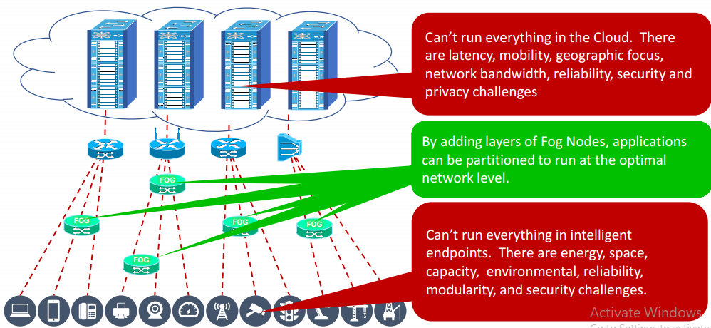
01
Overview of Cloud Computing

Slide 30
Cloud Definitions
Feature | Cloud Computing | Fog Computing
Latency | Cloud computing has high latency compared to fog computing | Fog computing has low latency
Capacity | Cloud Computing does not provide any reduction in data while sending or transforming data | Fog Computing reduces the amount of data sent to cloud computing.
Responsiveness | Response time of the system is low. | Response time of the system is high.
Security | Cloud computing has less security compared to Fog Computing | Fog computing has high Security.
Speed | Access speed is high depending on the VM connectivity. | High even more compared to Cloud Computing.
Data Integration | Multiple data sources can be integrated. | Multiple Data sources and devices can be integrated.
Mobility | In cloud computing mobility is Limited. | Mobility is supported in fog computing.
Location Awareness | Partially Supported in Cloud computing. | Supported in fog computing.
Number of Server Nodes | Cloud computing has Few number of server nodes. | Fog computing has Large number of server nodes.
Geographical Distribution | It is centralized. | It is decentralized and distributed.
Location of service | Services provided within the internet. | Services provided at the edge of the local network.
Working environment | Specific data center building with air conditioning systems | Outdoor (streets,base stations, etc.) or indoor (houses, cafes, etc.)
Communication mode | IP network | Wireless communication: WLAN, WiFi, 3G, 4G, ZigBee, etc. or wired communication (part of the IP networks)

Slide 31
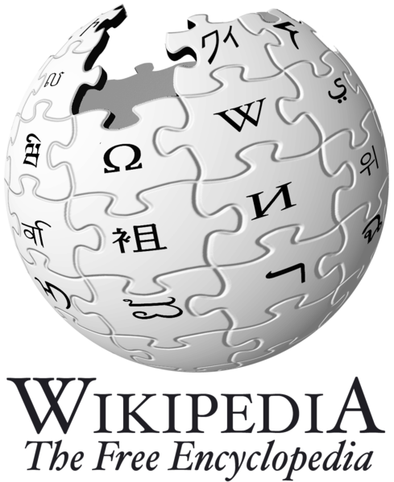
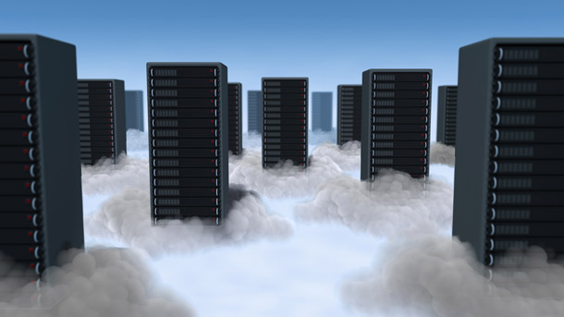
Cloud Definitions
Definition from Wikipedia
Cloud computing is Internet-based computing, whereby shared resources, software, and information are provided to computers and other devices on demand, like the electricity grid.
Cloud computing is a style of computing in which dynamically scalable and often virtualized resources are provided as a service over the Internet.

Slide 32
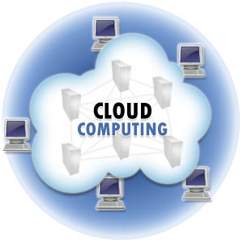
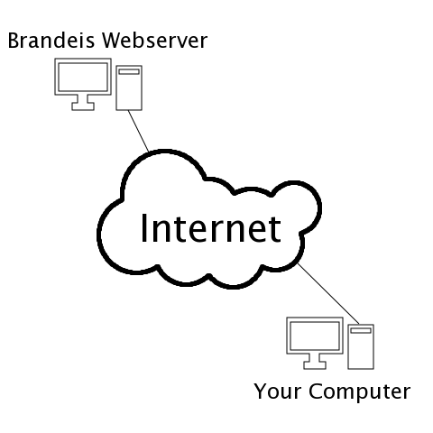
Cloud Definitions
Definition from Whatis.com
The name cloud computing was inspired by the cloud symbol that's often used to represent the Internet in flowcharts and diagrams.
Cloud computing is a general term for anything that involves delivering hosted services over the Internet.

Slide 33

Cloud Definitions
Definition from Berkeley
Cloud Computing refers to both the applications delivered as services over the Internet and the hardware and systems software in the datacenters that provide those services.
The services themselves have long been referred to as Software as a Service (SaaS), so we use that term. The datacenter hardware and software is what we will call a Cloud.
When a Cloud is made available in a pay-as-you-go manner to the public…… The service being sold is Utility Computing.

Slide 34
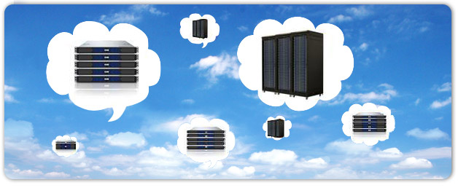
Cloud Definitions
Definition from Buyya
A Cloud is a type of parallel and distributed system consisting of a collection of interconnected and virtualized computers that are dynamically provisioned and presented as one or more unified computing resources based on service-level agreements established through negotiation between the service provider and consumers.

Slide 35

Cloud Definition
Definition from NIST (National Institute of Standards and Technology)
Cloud computing is a model for enabling convenient, on-demand network access to a shared pool of configurable computing resources (e.g., networks, servers, storage, applications, and services) that can be rapidly provisioned and released with minimal management effort or service provider interaction.
This cloud model promotes availability and is composed of five essential characteristics, three service models, and four deployment models.
Cloud computing is a paradigm of computing, a new way of thinking about IT industry but not any specific technology.

Slide 36
Cloud computing is the way to access computing technique through internet.
It consists of both software and hardware services, so that the user can locate easily anywhere in the world. .
Recently, academics as well as business industries paid a great deal of attention to cloud computing.
The main objective of cloud computing is to reduce the cost of application tools and provide 24X7 hours online services to the user.

Slide 37
The term cloud refers to a network or the internet.
It is a technology that uses remote servers on the internet to store, manage, and access data online rather than local drives.
There are the following operations that we can do using cloud computing:
Developing new applications and services
Storage, back up, and recovery of data
Hosting blogs and websites
Delivery of software on demand
Analysis of data
Streaming videos and audios

Slide 38
Why Cloud Computing?
Small as well as large IT companies, follow the traditional methods to provide the IT infrastructure. That means for any IT company, we need a Server Room that is the basic need of IT companies.
In that server room, there should be a database server, mail server, networking, firewalls, routers, modem, switches, QPS (Query Per Second means how much queries or load will be handled by the server), configurable system, high net speed, and the maintenance engineers.
To establish such IT infrastructure, we need to spend lots of money. To overcome all these problems and to reduce the IT infrastructure cost, Cloud Computing comes into existence.

Slide 39
Cloud Computing Characteristics
Common Characteristics:
Massive Scale
Resilient Computing
Homogeneity
Geographic Distribution
Virtualization
Service Orientation
Low Cost Software
Advanced Security
Essential Characteristics:
On Demand Self-Service
Broad Network Access
Rapid Elasticity
Resource Pooling
Measured Service
Notes:
ScalabilityInfrastructure capacity allows for traffic spikes and minimizes delays.
ResiliencyCloud providers have mirrored solutions to minimize downtime in the event of a disaster. This type of resiliency can give businesses the sustainability they need during unanticipated events.
Homogeneity: No matter which cloud provider and architecture an organization uses, an open cloud will make it easy for them to work with other groups, even if those other groups choose different providers and architectures.
On-demand self-service. A consumer can unilaterally provision computing capabilities, such as server time and network storage, as needed automatically without requiring human interaction with each service’s provider.
Broad network access. Capabilities are available over the network and accessed through standard mechanisms that promote use by heterogeneous thin or thick client platforms (e.g., mobile phones, laptops, and PDAs).
Resource pooling. Multi-tenant model.. There is a sense of location independence in that the customer generally has no control or knowledge over the exact location of the provided resources but may be able to specify location at a higher level of abstraction (e.g., country, state, or datacenter). Examples of resources include storage, processing, memory, network bandwidth, and virtual machines.
Rapid elasticity. Capabilities can be rapidly and elastically provisioned, in some cases automatically, to quickly scale out and rapidly released to quickly scale in. To the consumer, the capabilities available for provisioning often appear to be unlimited and can be purchased in any quantity at any time.
Measured Service. Cloud systems automatically control and optimize resource use by leveraging a metering capability at some level of abstraction appropriate to the type of service (e.g., storage, processing, bandwidth, and active user accounts).

Slide 40
Characteristics Cloud Computing
According to the US National Institute of Standards and Technology (NIST) and Sun Microsystems, Cloud services are based upon five principal characteristics that identify their relation, and differences from the traditional computing approach.
Essential Characteristics:
On Demand Self-Service
Broad Network Access
Rapid Elasticity
Resource Pooling
Measured Service

Slide 41
Characteristics Cloud Computing
According to the US National Institute of Standards and Technology (NIST) and Sun Microsystems, Cloud services are based upon five principal characteristics that identify their relation, and differences from the traditional computing approach.
Essential Characteristics:
On Demand Self-Service
Broad Network Access
Rapid Elasticity
Resource Pooling
Measured Service

Slide 42
Characteristics (Features) of Cloud Computing
1. On-demand self-service:
The Cloud computing services does not require any human administrators, user themselves are able to provision, monitor and manage computing resources as needed.
A consumer can separately provision computing capabilities, such as server time and network storage, as needed automatically
Customer can access at any time and anywhere
Customer can upgrade /downgrade at any time
2. Broad network access:
Cloud computing resources are available over the network and can be accessed by diverse customer platforms.
high broadband communication link—such as the internet, or in the case of a private clouds it could be a local area network (LAN).
Network bandwidth and latency are very important aspects of cloud computing and broad network access, because they relate to the quality of service (QoS) on the network.

Slide 43
3. Resource pooling:
Resource pooling means a cloud service provider can share resources among several clients, providing everyone with a different set of services per their requirements.
It is a multi-client strategy that can be applied to data storage, processing, and bandwidth-provided services.
Resource pooling means that multiple customers are serviced from the same physical resources.
The provider's computing resources are pooled to serve multiple consumers using a multi-tenant model, with different physical and virtual resources dynamically assigned and reassigned according to consumer demand.

Slide 44
4. Rapid elasticity:
enables the cost-effective running of workloads that require a vast number of servers but only for a short period.
Capabilities can be elastically provisioned and released, in some cases automatically
Customer resource scalability
Customer resource flexibility
5. Measured service:
Cloud systems automatically control and optimize resource use by leveraging a metering capability at some level of abstraction appropriate to the type of service (e.g., storage, processing, bandwidth and active user accounts).

Slide 45
Advantages of Cloud Computing
Cost: It reduces the huge capital costs of buying hardware and software.
Speed: Resources can be accessed in minutes, typically within a few clicks.
Scalability: We can increase or decrease the requirement of resources according to the business requirements.
Productivity: While using cloud computing, we put less operational effort. So, in this way, the IT team can be more productive and focus on achieving business goals.
Reliability: Backup and recovery of data are less expensive and very fast for business continuity
Security: Many cloud vendors offer a broad set of policies, technologies, and controls that strengthen our data security.

Slide 46
Disadvantages of Cloud Computing
Requires good speed internet with good bandwidth: access your cloud services, you need to have a good internet connection always with good bandwidth to upload or download files to/from the cloud
Downtime : Since the cloud requires high internet speed and good bandwidth, there is always a possibility of service outage, which can result in business downtime
Limited control of infrastructure : Since you are not the owner of the infrastructure of the cloud, hence you don’t have any control or have limited access to the cloud infra
Restricted or limited flexibility :The cloud provides a huge list of services, but consuming them comes with a lot of restrictions and limited flexibility for your applications or developments

Slide 47
Ongoing costs: Although you save your cost of spending on whole infrastructure and its management, on the cloud, you need to keep paying for services as long as you use them
Security : Security of data is a big concern for everyone. Since the public cloud utilizes the internet, your data may become vulnerable
Vendor Lock-in : Although the cloud service providers assure you that they will allow you to switch or migrate to any other service provider whenever you want, it is a very difficult process.
Technical issues : Even if you are a tech whiz, the technical issues can occur, and everything can’t be resolved in-house.
To avoid interruptions, you will need to contact your service provider for support. However, not every vendor provides 24/7 support to their clients.

Slide 48
Limitations Cloud computing
Cloud computing has also some limitations. It includes
time-consuming task for large data when the data and applications are processed in a cloud,
The problem of bandwidth as a result of sending every bit of data over cloud channels, slow response time and scalability problems as a result of depending servers that are located at remote places.
The number of devices being connected to the Internet is tremendously increasing.

Slide 49
Limitations Cloud computing
The devices that are being connected are powerful in the sense that these devices are able to communicate with each other.
This type of communication is called Machine to Machine(M2M) communication.
In other words, this paradigm is known as the Internet of Things. Cloud computing is being a primary factor for IoT, ubiquity, scalability, providing reliability and high performance.
Cloud computing-based IoT is not appropriate for applications because of its geographically centralized nature as well as communication implications that need geographically distributed, a very low and predictable latency, fast mobility, and large-scale distributed control systems .

Slide 50
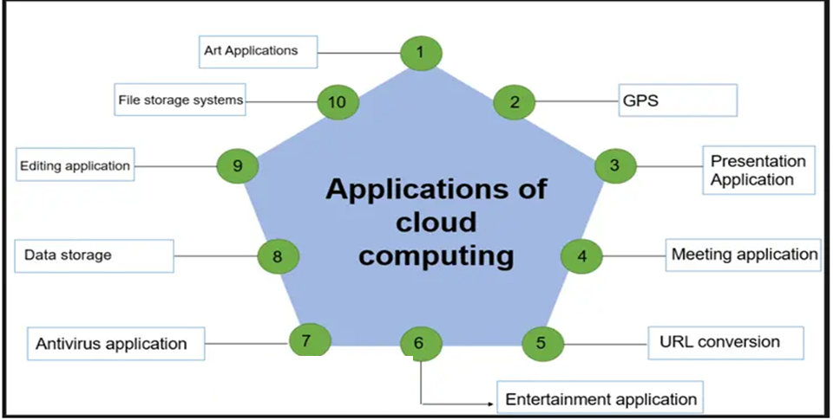
Application of Cloud Computing

Slide 51
Thank You
Question ??
4

